Slide 1
Speech Recognition Algorithms and Optimization Neural Transduces & LAS
Wonyong Sung
Signal Processing Systems Lab @ SNU

Slide 2
End-to-end Speech Recognition
Modularized approach (Hybrid)
Acoustic model (CTC)
Language model and beam-search
Separate optimization
Pure end2end approach
Integration of AM and LM
LAS (Listen Attend and Spell) (Chan et al., “Listen, Attend and Spell”)
RNN-T (Transducer) (Graves et al., “Sequence transduction with recurrent neural networks”)

Slide 3
Contents
Neural Transducers
Listen Attend Spell (LAS)
Comparison of CTC, Neural Transducers, LAS
Implementation Considerations
Some RNN-T slides from
https://www.cc.gatech.edu/classes/AY2021/cs7643_spring/assets/L24_rnnt_asr_tutorial_gt.pdf

Slide 4
CTC Acoustic Model 의 문제
CTC 의 independence 가정이 성능에 미치는 영향
AM에서 output label 을 얻은 뒤에 그 결과를 좋기 위해서 LM(language model)을 이용한 beam-search decoding 을 해야 하는데, 좋은 성능을 얻기 위해서는 beam width 가 커야 한다.
이 beam width 가 보통 32~ 128 을 사용한다.
RNN LM을 사용할 경우 전체 계산량의 측면에서 AM 보다 RNN LM 에 필요한 것이 훨씬 더 많다. (N-gram LM의 경우에는 계산이 적지만 (memory look-up) 성능이 떨어지고 또 병렬처리 계산의 이점을 살리지 못한다. 갈수록 RNN 이나 Transformer LM 대비 경쟁력이 떨어진다.
해결 – AM과 LM 을 integrate 하여 end-to-end training 한다.

Slide 5
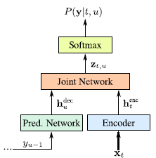
Neural Transducers
Neural Transducers: Similar to CTC (encoder), but include LM (prediction network) to overcome the conditional independence problem of CTC
Encoder (acoustic modeling), prediction network (LM), joint network (assemble the acoustic and prediction)
Joint network merges the probabilities in algorithm or using feed-forward neural network.
Graves, Alex. "Sequence transduction with recurrent neural networks." arXiv preprint arXiv:1211.3711 (2012).

Slide 6
2. Neural Transducers
- Graves, Alex. "Sequence transduction with recurrent neural networks."
arXiv preprint arXiv:1211.3711 (2012).
- Rao, Kanishka, Haşim Sak, and Rohit Prabhavalkar. "Exploring architectures, data and
units for streaming end-to-end speech recognition with RNN-transducer." Automatic
Speech Recognition and Understanding Workshop (ASRU), 2017 IEEE. IEEE, 2017.

Slide 7

Transcription network (acoustic model): speech input xt to its label probabilities (K+1 labels including null)
(Text) Prediction network: a kind of language model with K+1 output labels (including null label)
Output symbol
with null
Joint network
gu
ft
Predic-tion network
Trans-cription network
xt

Slide 8
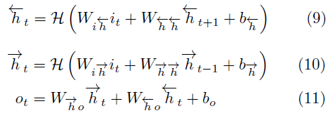
Transcription network
Acoustic input to labels.
Bidirectional RNN: the labels include null (K+1 labels). In Graves 2012 paper, phonemes are used for labels.

Slide 9
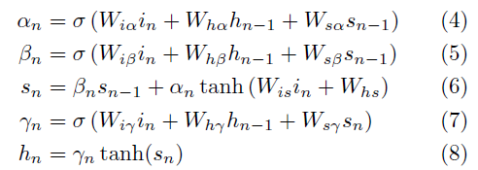
Prediction network
The input is one-hot encoded to represent K labels (all zero corresponds to the blank label)
The output is the probability distribution of K+1 labels (including blank)
The output sequence is modeled as (blank, y₁, y₂, …, y_{U})
The network can be built using uni-directional LSTM RNN

Slide 10
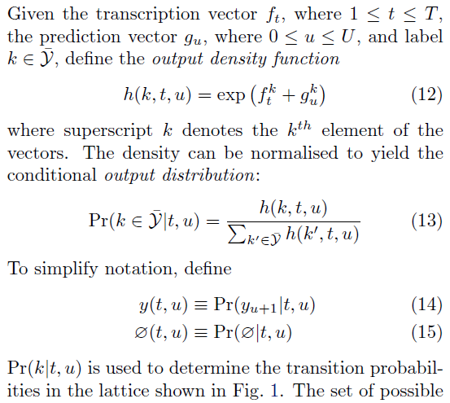
Output distribution

Slide 11
Output probability lattice
Moving horizontal direction: Probability of horizontal arrow leaving node t, u represents the prob of Null(t, u)
Moving vertical direction: represents the probability of y(t, u) of outputting element u+1 of y.

Slide 13
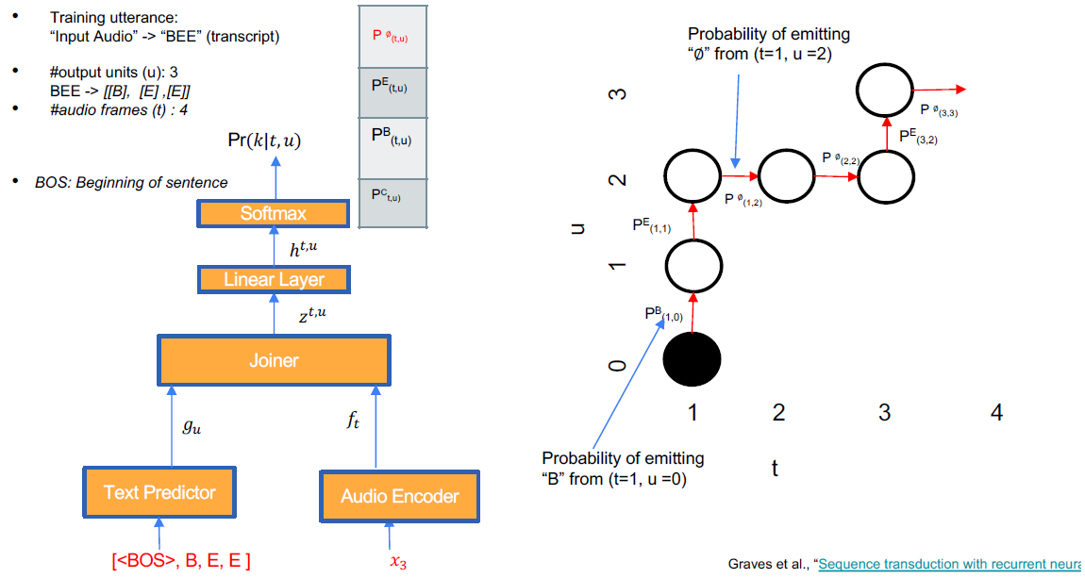
Alignment example during training (1)

Slide 14
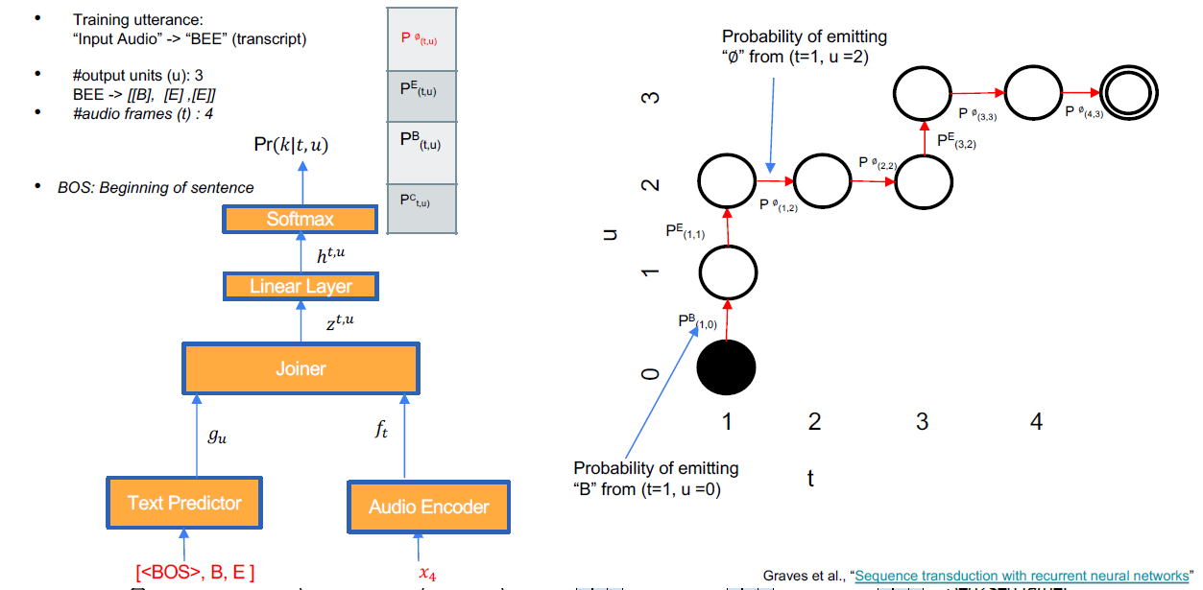
Alignment example (2)

Slide 15
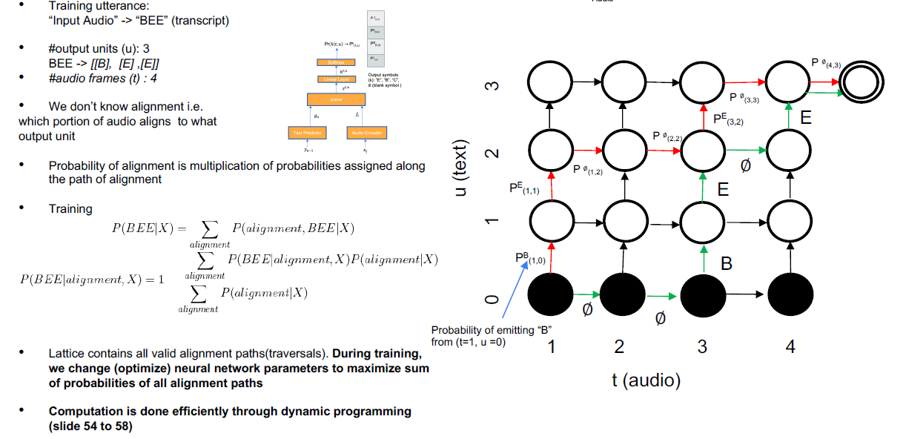
RNN-T lattice

Slide 16
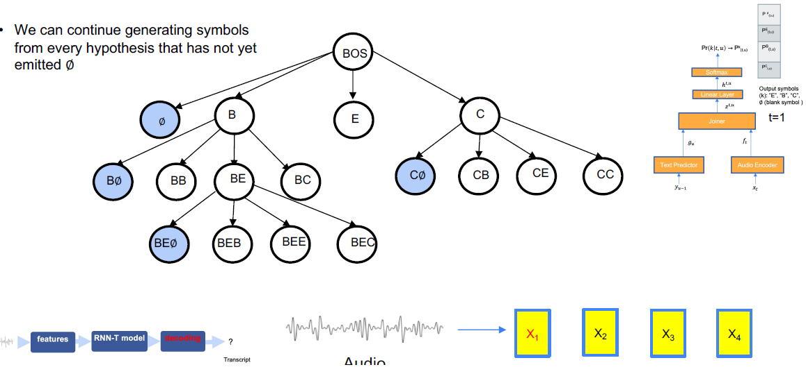
A subset of hypotheses

Slide 17
Beam search
We do not want to stay in time frame “t” forever. But we do not know when to move to “t+1” as there are many candidates that can be emitted at “t”.
n candidate hypotheses at time frame before exiting to decode at “t”. n is the hyper parameter.

Slide 18
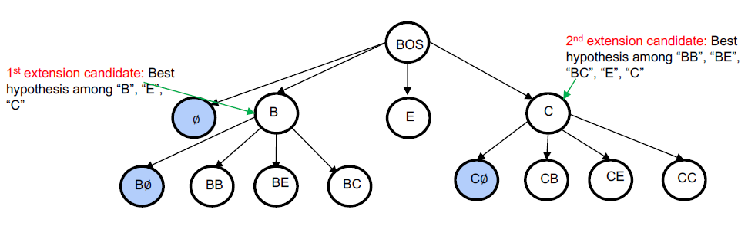
Beam search

Slide 19
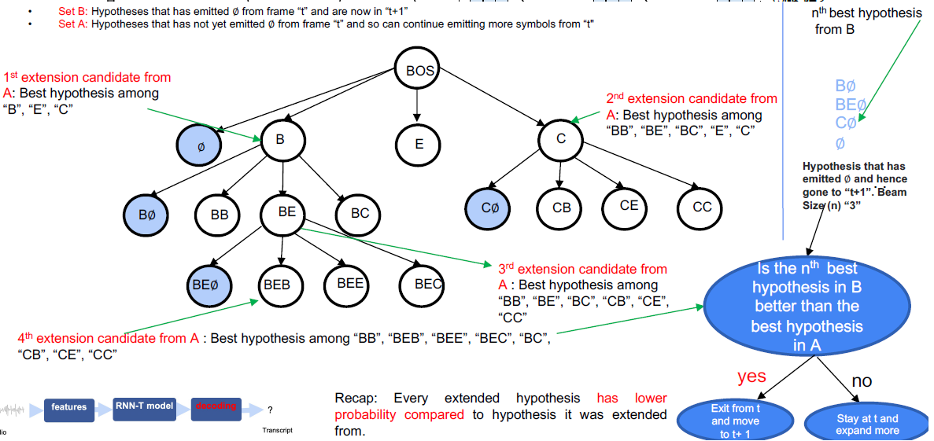
Beam search with beamwidth (n)

Slide 20
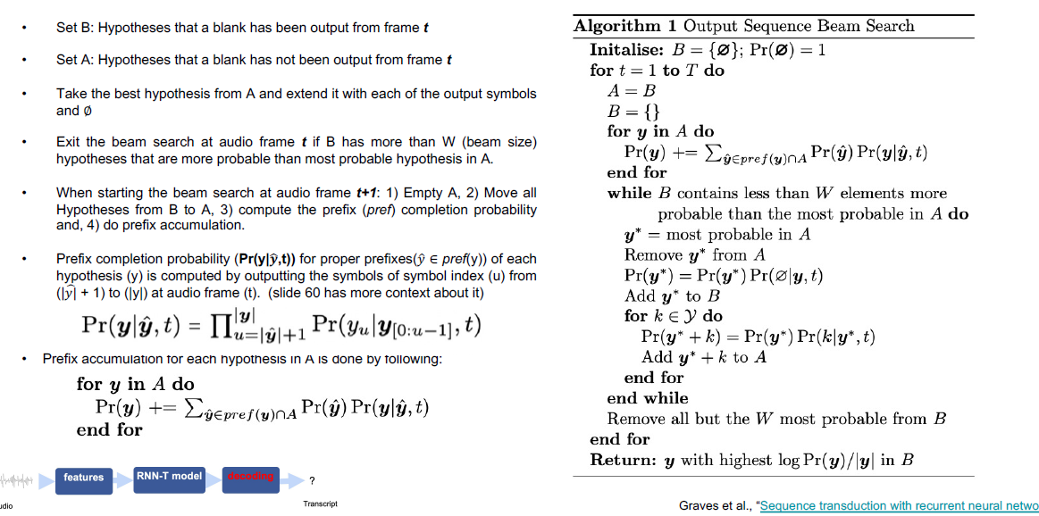
Beam search algorithm

Slide 21
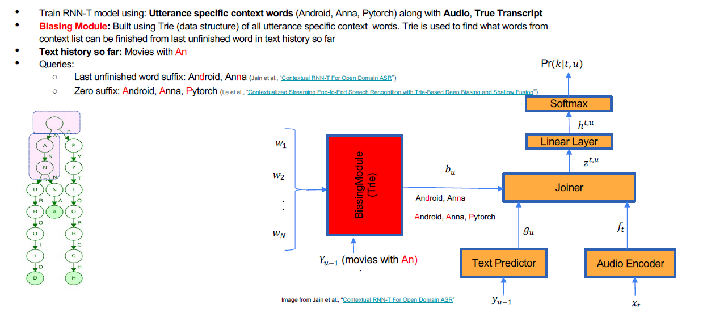
Utilizing context specific biasing modules

Slide 22
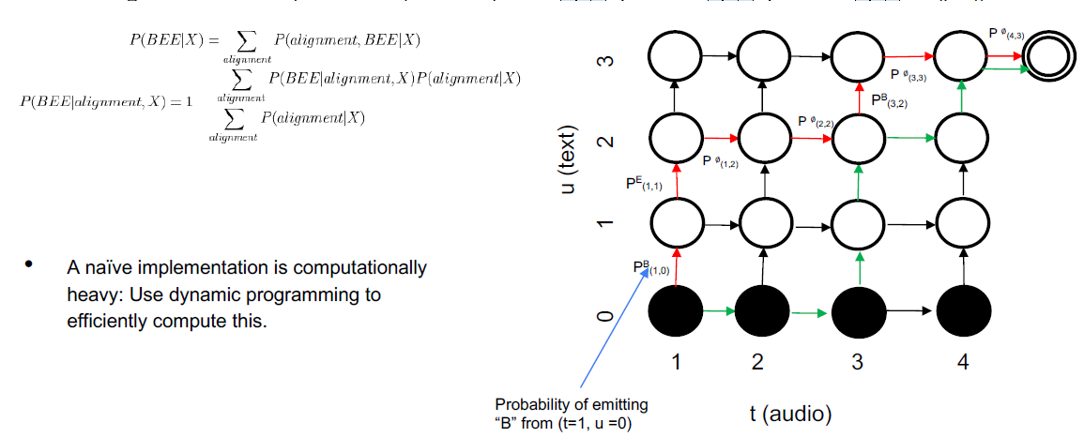
Training – lattice with complete set of paths

Slide 23
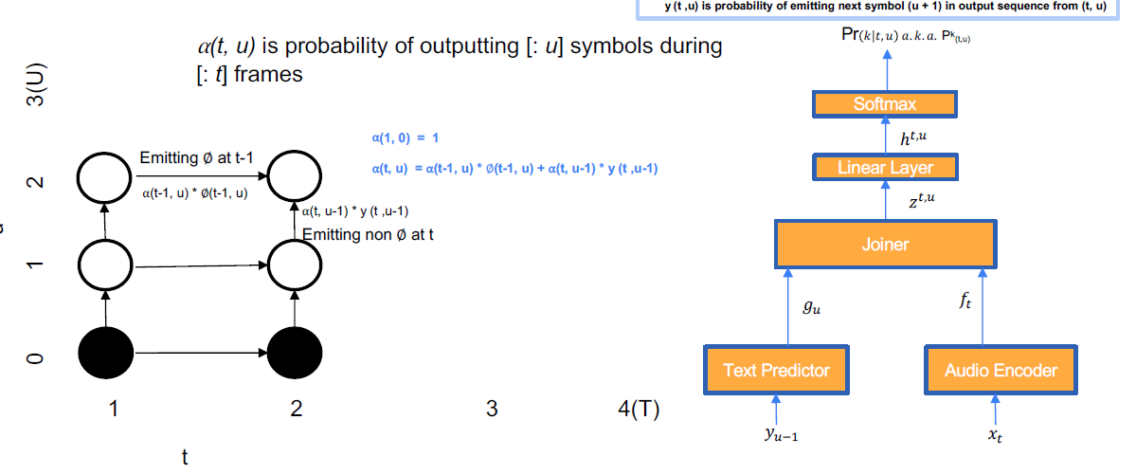
Training with forward and backward variables

Slide 24
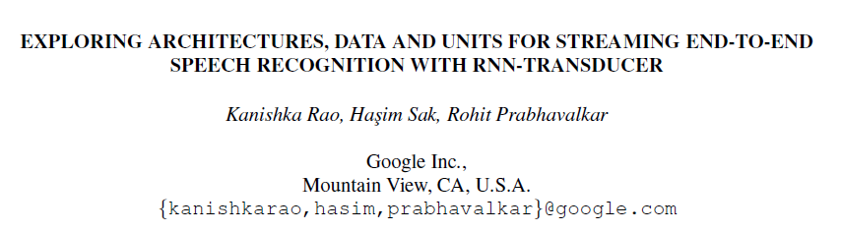
Rao, Kanishka, Haşim Sak, and Rohit Prabhavalkar. "Exploring architectures, data and units for streaming end-to-end speech recognition with RNN-transducer." Automatic Speech Recognition and Understanding Workshop (ASRU), 2017 IEEE. IEEE, 2017.

Slide 25
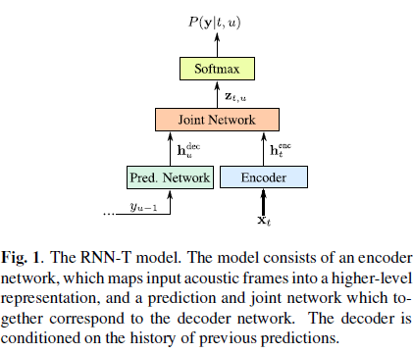
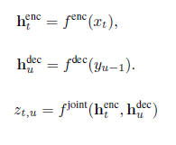
RNN - Transducer
Encoder – CTC pre-trained acoustic to grapheme or word-piece prob.
Prediction network – Pre-trained LM
Joint network: Fully connected neural network

Slide 26
Inference
If the predicted label, y_{u}, is non-blank, then the prediction network is updated with that label as input to generated the next output label prob p(y|t, u+1).
If a blank label is predicted then the next acoustic frame, x_{t+1}, is used to update the encoder while retain the same prediction network output.
Alternatively, updating the encoder and the prediction network (LM)

Slide 27
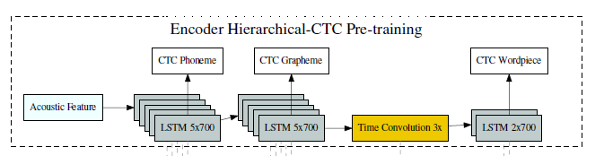
Pre-training
Grapheme based model: pre-training helps improving the WER (13.9% to 13.2% for voice search, 8.4% to 8.0% for voice dictation)

Slide 28
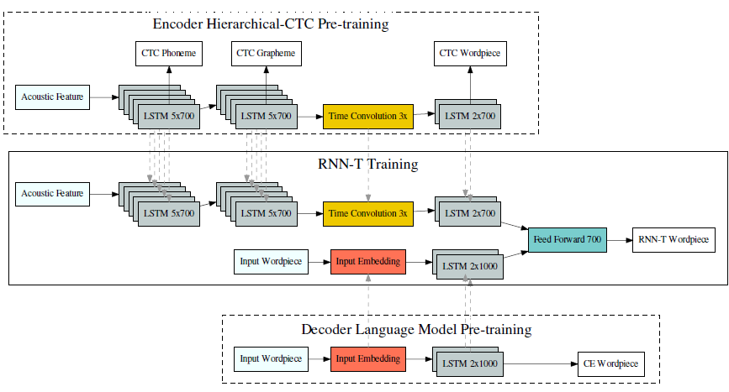

Slide 30
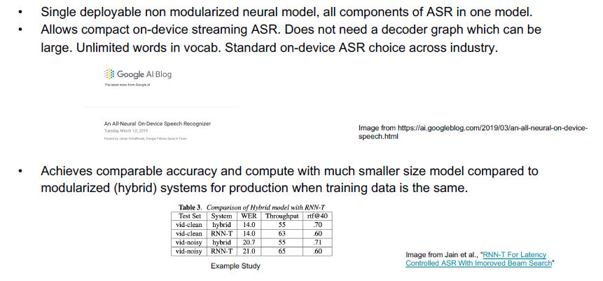
Why RNN-T from a product point of view
https://www.cc.gatech.edu/classes/AY2021/cs7643_spring/assets/L24_rnnt_asr_tutorial_gt.pdf

Slide 31
3. Listen Attend and Spell
Bahdanau, Dzmitry, Kyunghyun Cho, and Yoshua Bengio. "Neural machine translation by jointly learning to align and translate." arXiv preprint arXiv:1409.0473 (2014).
Chan, W., Jaitly, N., Le, Q., & Vinyals, O. (2016, March). Listen, attend and spell: A neural network for large vocabulary conversational speech recognition. In Acoustics, Speech and Signal Processing (ICASSP), 2016 IEEE International Conference on (pp. 4960-4964). IEEE. (Google Brain)

Slide 32
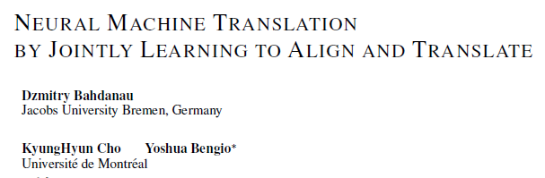
Review - Neural machine translation
음성인식도 일종의 번역
음성(encoder) -> text (decoder)
음성은 text 에 비해서 엄청 길다 (frame 수가 많다)
Alignment 가 중요 (attention 필요)

Slide 33
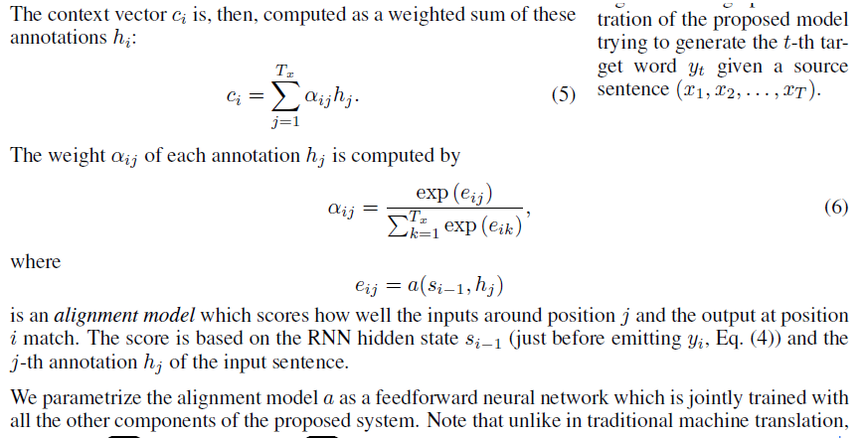

Slide 34
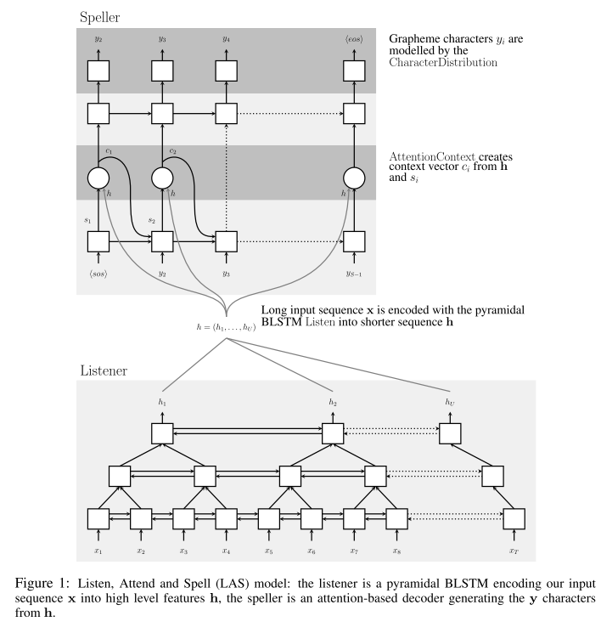
Listen, Attend and Spell
Conditional RNN
Attention
Pyramidal RNN (3):
1/8로 축소

Slide 35
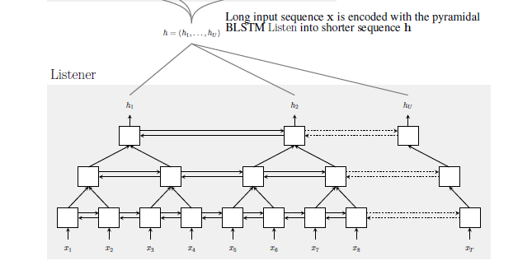
Listener
Listener compresses the input x by using pyramid bi-directional RNN (LAS is basically bi-directional)
Pyramid structure conducts time domain scaling for complexity reduction (up to 1/32)

Slide 36
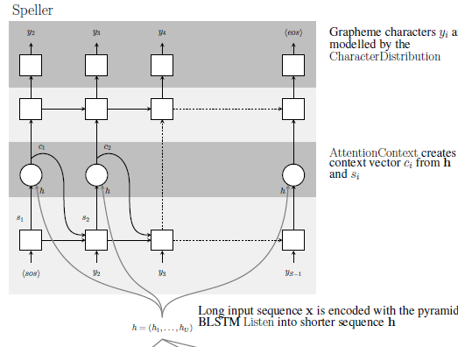

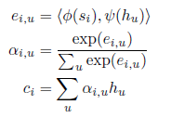
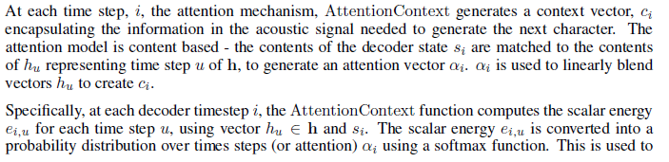
Attend and Spell

Slide 37
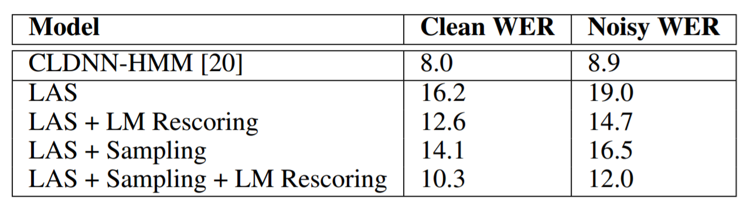
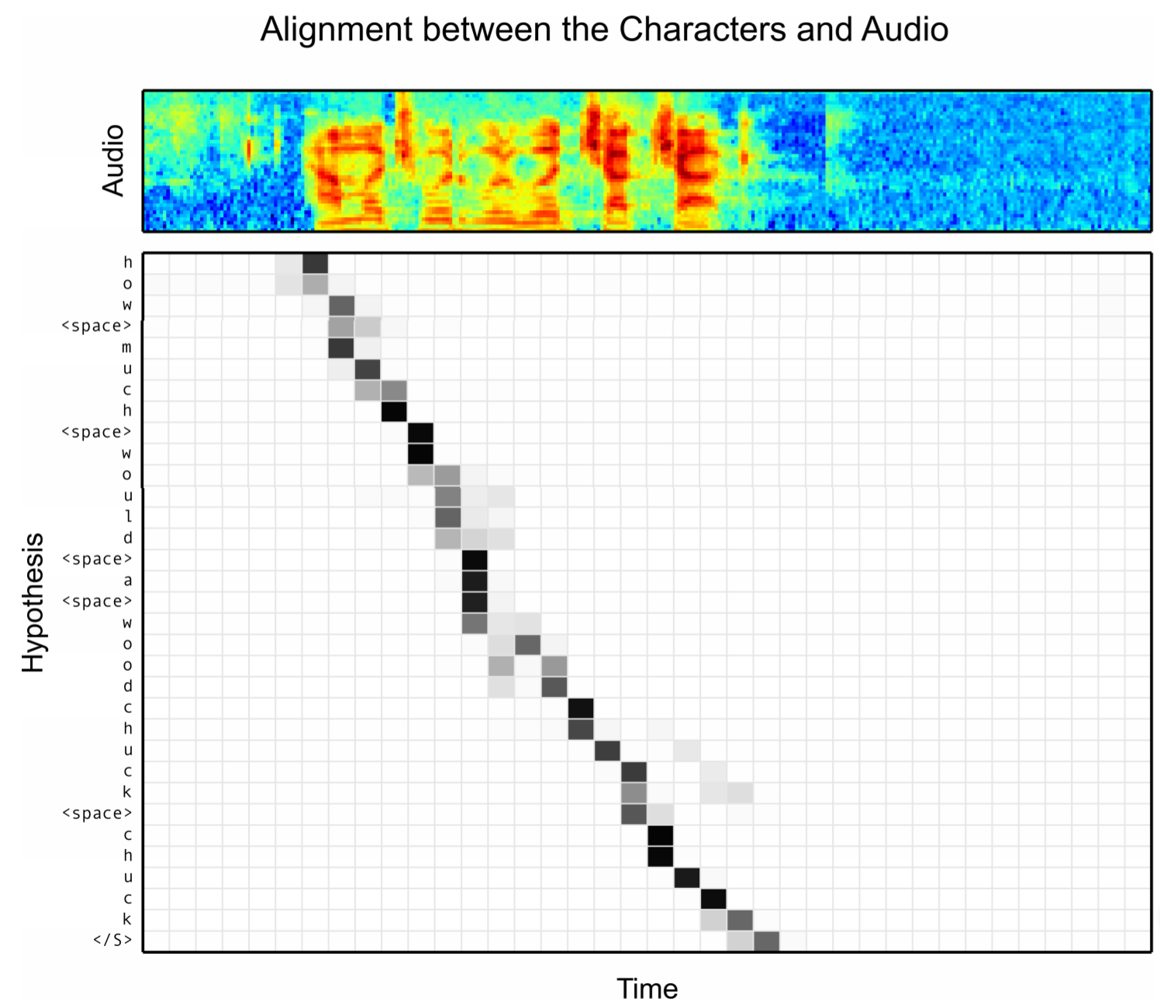
Listen, Attend and Spell
Not state-of-the-art
Comparable results.
Less Beam search
No dictionary.
Smaller beam width (32)
Decoding does not need LM
Attention complexity is
proportional to the input length

Slide 38
Comparison of CTC, RNN-T, and LAS

Slide 39
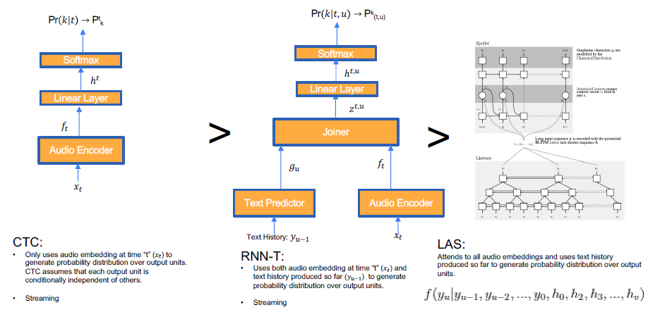
Conditional independence assumption

Slide 40
Battenberg, Eric, et al. "Exploring neural transducers for end-to-end speech recognition." arXiv preprint arXiv:1707.07413 (2017 July).

Slide 41
CTC, Neural Transducer, LAS Comparison
Conditional independence between predictions at different time steps, given audio. (-) CTC makes this assumption, but (+) RNN-Transducers and Attention models do not.
The alignment between input and output units is monotonic. A reasonable assumption for the ASR task, which enables models to do streaming transcription. (+) CTC and RNN-Transducers make this assumption, but (-) Attention models 1 do not.
Hard vs Soft alignments. the attention mechanism models a soft alignment between each output step and every input step.
CTC – insufficient model, Attention – surplus model

Slide 42
Fisher SWBD results
LM is paired with the dataset (not text only) (it does not improve much)
Attention and RNN-Transducer both use a beam width of 32.

Slide 43
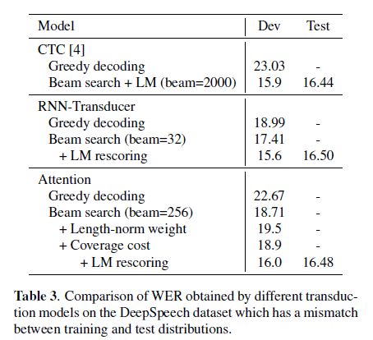
DeepSpeech Corpus
10,000 hours in the diverse set of scenarios, such as far field, noise accents

Slide 44
Forward only encoders
For streaming applications, forward only encoders are needed.
Replacing the bidirectional layers with forward-only recurrent layers. Note that while this immediately makes CTC and RNN-Transducer models deployable, attention models still need to be able to process the entire utterance before outputting the first character.

Slide 45
Down-sampling in the encoder
Down sampling reduces the arithmetic/memory complexity.
Since RNN-Transducers and attention models can output multiple characters for the same encoder time step, we expect RNN-Transducers to be as robust as attention models as we increase the amount of pooling in the encoder. While Figure 2 shows that they are fairly robust compared the CTC models, we find that attention models are significantly more robust.

Slide 46
Comparison of CTC, RNN-T, and Attention models.
In the bidirectional setting, all three models perform roughly the same. In forward direction only, CTC best.
CTC - simplify the training process but still require to be decoded with large language models. Large beam width.
RNN Transducers have simple decoding process with no extra hyper-parameters tuning, which leads us to believe that RNN-Transducers present the next generation of end-to-end speech models.
Attention also simplify the decoding process and require the language models to be introduced only in a post processing stage to be equally if not more effective. Strength in down sampling.

